Slide 1
Data Ingestion
In this lesson, we'll …
Lesson 3

Slide 2







GenAI Solutions follow a similar high-level ‘workflow’
1. Ensure Your Data & Systems are ‘GenAI-Ready’
TBD
7. Deliver a High-Quality Response
2. Understand the User’s Request
TBD
TBD
6. Check for Quality and ‘Toxicity’
High-Level
GenAI
Flow
3. Route the Request(s)
TBD
TBD
5. Generate a Targeted Response
4. Aggregate Required Data & Context
TBD
TBD

Slide 3
Data Ingestion - Why
Problem:
LLMs are trained offline on a massive corpus and unaware of events after training
LLMs do not know your business proprietary or domain specific data
LLMs do not have real-time information
Solution:
Feed the LLM relevant context in real-time, by using an information retrieval system

Slide 4


Slide 5
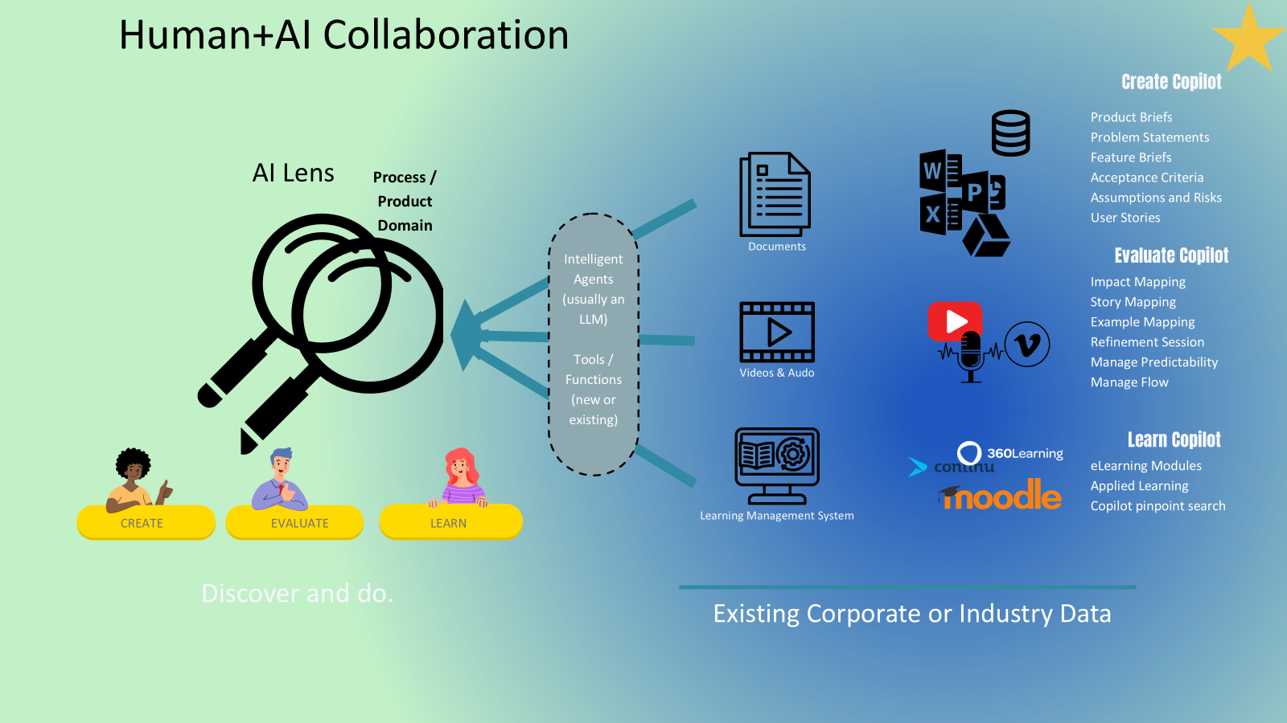

Slide 6
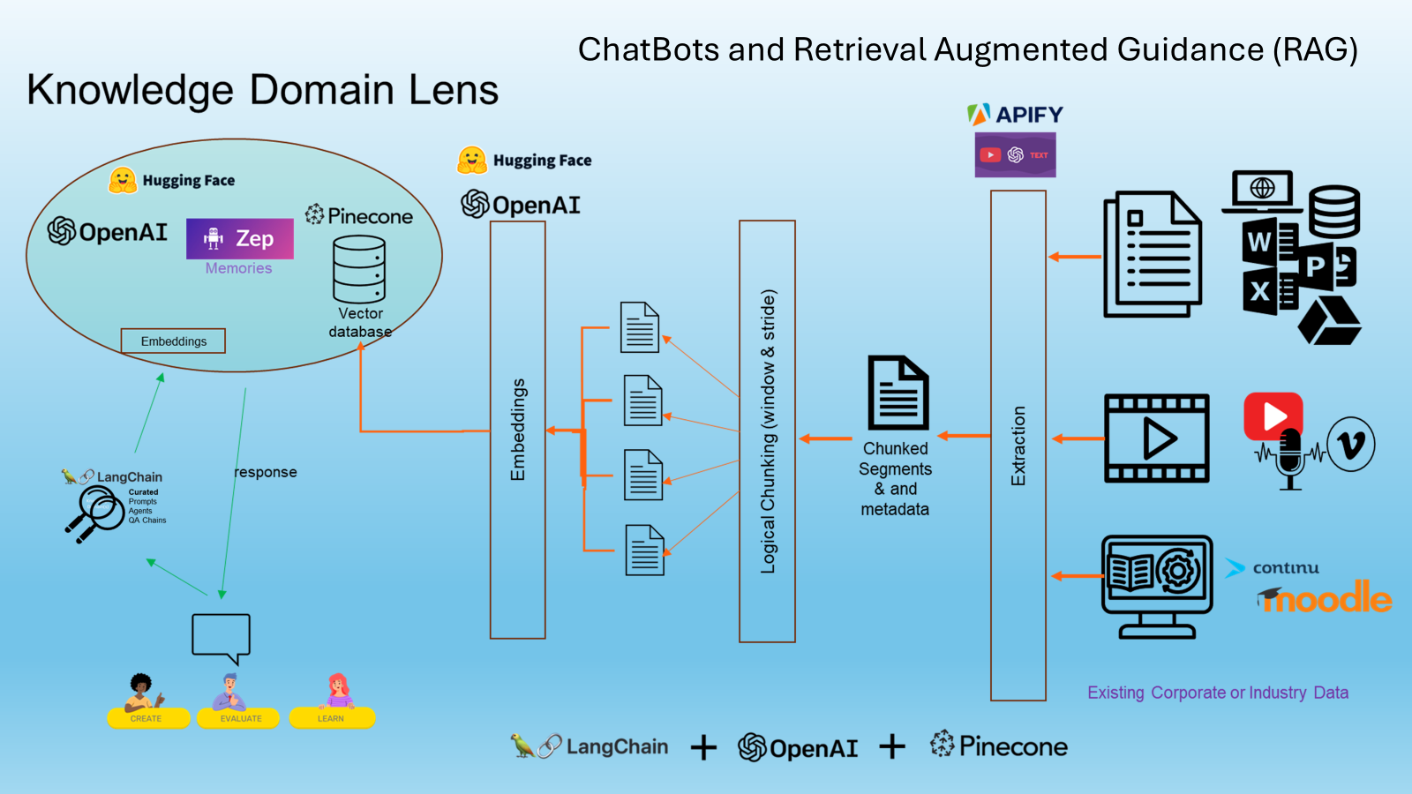

Slide 7
Learn how to use a Data Loader
Learn how do chunk data
Learn how to create embeddings
Learn how to store embeddings
Learn how to visualize embeddings

Slide 8
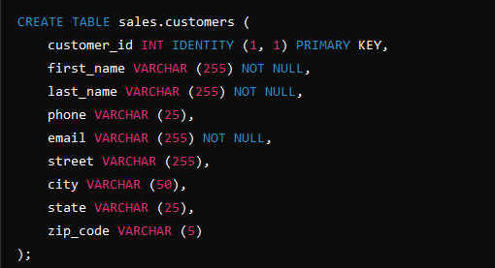
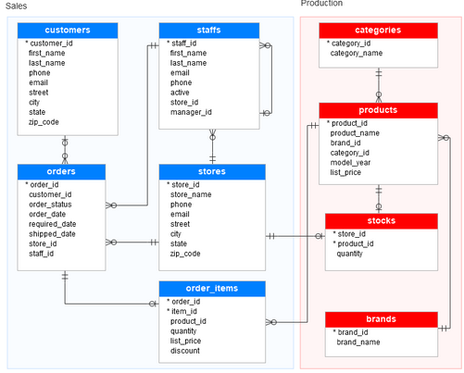
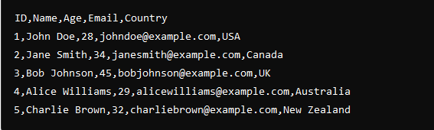
Types of Data: Structured
Database
Comma separated variables - CSV

Slide 9





Types of Data: Unstructured
Text
Video
Image

Slide 10
Data Sources
Databases
API (Application Programming Interface)
Web Scraping
Public Datasets
Wikipedia API
IMDB API
OpenWeatherMap API
Twitter API
Spotify API
NASA API
BeautifulSoup
Scrapy
Selenium (Browser Automation
Cheerio (Node.js Library)
Kaggle Datasets
AWS Public Datasets
Data.gov
OpenStreetMap
NASA Earthdata
MySQL
Microsoft SQL Server
MongoDB
PostgreSQL
Examples
References
MySQL Tutorial
What is an API?
YouTube BeautifulSoup Tutorial
Kaggle Datasets Introduction
PyPi Wikipedia-API

Slide 11
Data Collection Techniques
Surveys and Questionnaires
Observational Methods
Experiments
Secondary Data Sources
Behavioral Studies
User Experience Research
Field studies
Ecological research
Clinical trials
Psychological research
Educational interventions
Product testing
Economic Analysis
Demographic studies
Meta-analysis
Policy research
SurveyMonkey
Qualtrics Survey Software
Examples
References
SurveyMonkey
Observational Research Methods
Experimental Research Methods
NIH Need for Secondary Research

Slide 12
LangChain Framework
LangChain Document Loaders
LangChain Embedding Models
LangChain Vectorstores

Slide 13

Embeddings
Imagine you have a huge box of crayons, and each crayon has a unique color. Now, let's say you want to describe your favorite toy to your friend using these crayons. Instead of drawing the toy, you pick a few crayons that best represent its colors. By just showing these crayons to your friend, they can get a good idea of what your toy looks like without seeing the actual toy.
Now, in the world of AI, "embeddings" are like those crayons. AI use embeddings to represent things like words or objects with a bunch of numbers, much like you used crayons to represent your toy's colors. This way, computers can easily understand and work with huge amounts of information without getting overwhelmed!

Slide 14
Embeddings - Why
Using embeddings in RAG systems significantly enhances the retrieval process by enabling semantic search, improving accuracy, and ensuring that the generation component has access to the most relevant information. This results in more accurate, contextually appropriate, and user-satisfying outputs.
By leveraging embeddings, RAG systems can move beyond the limitations of traditional keyword-based retrieval, handling complex queries, and providing high-quality responses that align closely with user intent. This makes embeddings a critical component in the development of advanced, efficient, and effective RAG systems.

Slide 15
Window and Stride
window: 5 Stride: 0 In the scenario where the stride length is zero, as depicted in the chunks:
“In Agile software development, iterative” repeating, the window remains stagnant, causing the LLM to analyze the same text chunk repetitively,
Conversely, a window of 5 with a stride of 3
chunk 1: “In Agile software development, iterative”
chunk 2: “development, iterative and incremental processes,”
chunk 3: “incremental processes are employed to.”
each chunk is unique, enabling the LLM to explore different facets of the sentence, hence, providing a broader view of the text’s context.

Slide 16
Coding Exercise
> git clone https://github.com/marty916/Enterprise-LLM-RAG.git
> cd Enterprise-LLM-RAG/lessons/03-data-ingestion

